Slide 1
Maths and Statistical Foundations for Analytics
Lecture7: Hypothesis Testing

Slide 2
7.1 The Nature of Hypothesis Testing

Slide 3
Definition 7.1
Null and Alternative Hypotheses; Hypothesis Test
Null hypothesis: A hypothesis to be tested. We use the
symbol
to represent the null hypothesis.
Alternative hypothesis: A hypothesis to be considered as an alternative to the null hypothesis. We use the symbol
to represent the alternative hypothesis.
Hypothesis test: The problem in a hypothesis test is to decide whether the null hypothesis should be rejected in favor of the alternative hypothesis.

Slide 4
Definition 8.2
Type I and Type II Errors
Type I error: Rejecting the null hypothesis when it is in fact true.
Type II error: Not rejecting the null hypothesis when it is in fact false.

Slide 5
Definition 7.3
Significance Level
The probability of making a Type I error, that is, of rejecting a true null hypothesis, is called the significance level, α , of a hypothesis test.

Slide 6
Key Fact 7.1
Relation between Type I and Type II Error Probabilities
For a fixed sample size, the smaller we specify the significance level, α, the larger will be the probability, β, of not rejecting a false null hypothesis.

Slide 7
Key Fact 7.2
Possible Conclusions for a Hypothesis Test
Suppose that a hypothesis test is conducted at a small significance level.
If the null hypothesis is rejected, we conclude that the data provide sufficient evidence to support the alternative hypothesis.
If the null hypothesis is not rejected, we conclude that the data do not provide sufficient evidence to support the alternative hypothesis.

Slide 8
7.2 Critical-Value Approach to Hypothesis Testing

Slide 9
Critical Value Approach
With the critical-value approach to hypothesis testing, we choose a “cutoff point” (or cutoff points) based on the significance level of the hypothesis test.
The criterion for deciding whether to reject the null hypothesis involves a comparison of the value of the test statistic to the cutoff point(s).

Slide 10
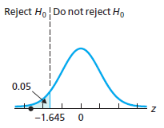
Figure 7-2
Criterion for deciding whether to reject the null hypothesis

Slide 11
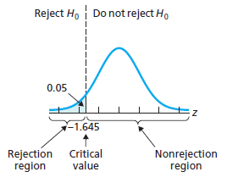
Figure 7-3
Rejection region, nonrejection region, and critical value for the golf-driving-distances hypothesis test

Slide 12
Definition 7.4
Rejection Region, Nonrejection Region, and Critical Values
Rejection region: The set of values for the test statistic that leads to rejection of the null hypothesis.
Nonrejection region: The set of values for the test statistic that leads to nonrejection of the null hypothesis.
Critical value(s): The value or values of the test statistic that separate the rejection and nonrejection regions. A critical value is considered part of the rejection region.

Slide 13
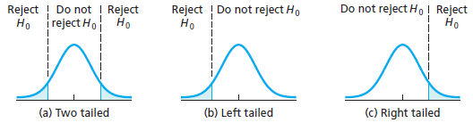
Figure 7-4
Graphical display of rejection regions for two-tailed, left-tailed, and right-tailed tests

Slide 14
Key Fact 7.3
Obtaining Critical Values
Suppose that a hypothesis test is to be performed at the significance level α. Then the critical value(s) must be chosen so that, if the null hypothesis is true, the probability is α that the test statistic will fall in the rejection region.

Slide 15
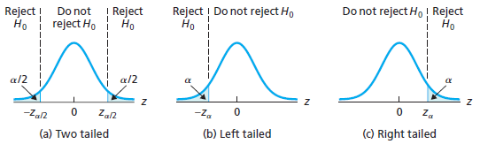
Figure 7-5
Critical value(s) for a one-mean z-test at the significance level α if the test is (a) two tailed, (b) left tailed, or (c) right tailed

Slide 16
7.3 Hypothesis Tests for One Population Mean When σ Is Known

Slide 17
Procedure 7.1 (1 of 2)
One-Mean z-Test
Purpose To perform a hypothesis test for a population mean, μ
Assumptions
Simple random sample
Normal population or large sample
σ known
Step 1 The null hypothesis is
and the alternative hypothesis is
Step 2 Decide on the significance level, α.
Step 3 Compute the value of the test statistic
and denote that value

Slide 18
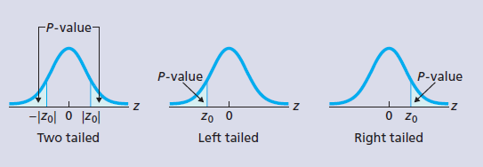
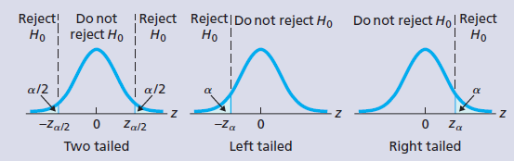
Procedure 7.1 (2 of 2)
Critical-value Approach
OR
P-value Approach
Step 4 The critical value(s) are
Step 4 Use Table Ⅱ to obtain the P-value.
Use Table Ⅱ to find the critical value(s).
Step 5 If the value of the test statistic falls in the rejection region, reject
Step 5 If P ≤ α, reject
otherwise, do not reject
otherwise, do not reject
Step 6 Interpret the results of the hypothesis test.
Note: The hypothesis test is exact for normal populations and is approximately correct for large samples from nonnormal populations.

Slide 19
Key Fact 7.7
When to Use the One-Mean z-Test
For small samples - say, of size less than 15 - the z-test should be used only when the variable under consideration is normally distributed or very close to being so.
For samples of moderate size - say, between 15 and 30 - the z-test can be used unless the data contain outliers or the variable under consideration is far from being normally distributed.
For large samples - say, of size 30 or more - the z-test can be used essentially without restriction. However, if outliers are present and their removal is not justified, you should perform the hypothesis test once with the outliers and once without them to see what effect the outliers have. If the conclusion is affected, use a different procedure or take another sample, if possible.
If outliers are present but their removal is justified and results in a data set for which the z-test is appropriate (as previously stated), the procedure can be used.

Slide 20
7.4 P-Value Approach to Hypothesis Testing

Slide 21
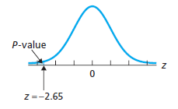
Figure 7-7
P-value for golf-driving-distances hypothesis test

Slide 22
Key Fact 7.4
Decision Criterion for a Hypothesis Test Using the P-Value
If the P-value is less than or equal to the specified significance level, reject the null hypothesis; otherwise, do not reject the null hypothesis. In
other words, if P ≤ α, reject
otherwise, do
not reject

Slide 23
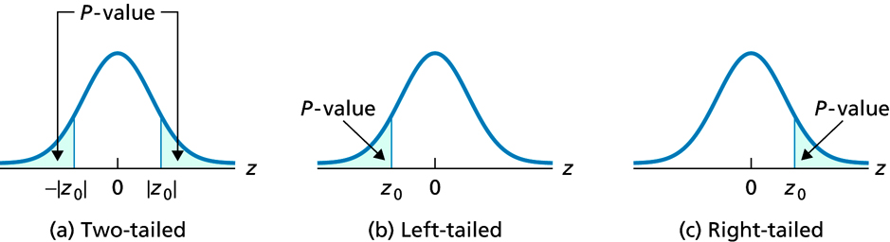
Figure 7-8
P-value for a one-mean z-test if the test is (a) two tailed, (b) left tailed, or (c) right tailed

Slide 24
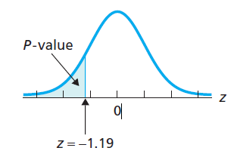
Figure 7-9
Value of the test statistic and the P-value

Slide 25
Table 8-7
General steps for the P-value approach to hypothesis testing
P-value Approach To Hypothesis Testing
Step 1 State the null and alternative hypotheses.
Step 2 Decide on the significance level, α.
Step 3 Compute the value of the test statistic.
Step 4 Determine the P-value, P.
Step 5 If P ≤ α, reject
otherwise, do not reject
Step 6 Interpret the result of the hypothesis test.

Slide 26
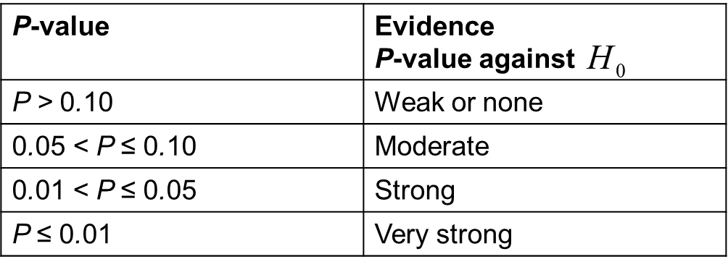
Table 7-8
Guidelines for using the P-value to assess the evidence against the null hypothesis

Slide 27
7.5 Hypothesis Tests for One Population Mean When σ Is Unknown

Slide 28
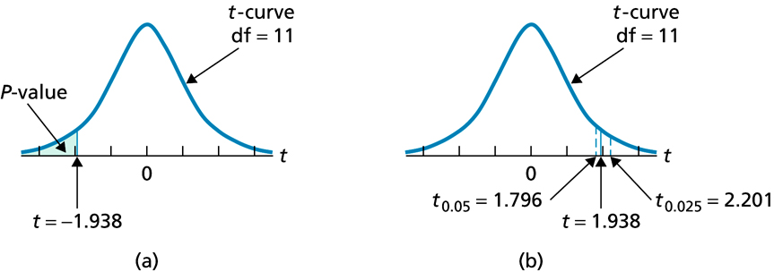
Figure 7-19
Estimating the P-value of a left-tailed t-test with a sample size of 12 and test statistic t = −1.938

Slide 29
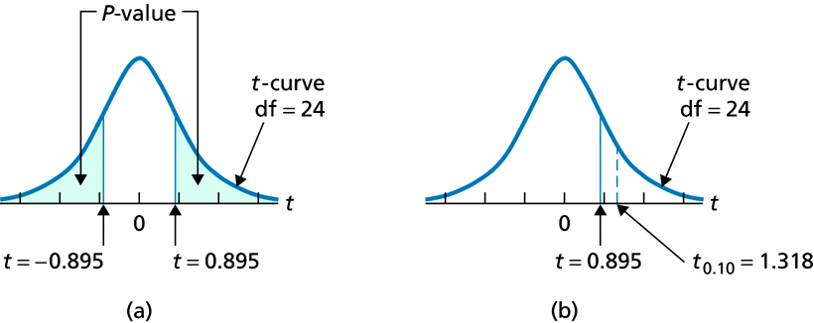
Figure 7-20
Estimating the P-value of a two-tailed t-test with a sample size of 25 and test statistic t =−0.895

Slide 30
Procedure 7.2 (1 of 2)
One-Mean t-Test
Purpose To perform a hypothesis test for a population mean, μ
Assumptions
Simple random sample
Normal population or large sample
σ unknown
Step 1 The null hypothesis is
and the alternative hypothesis is
Step 2 Decide on the significance level, α.
Step 3 Compute the value of the test statistic
and denote that value

Slide 31
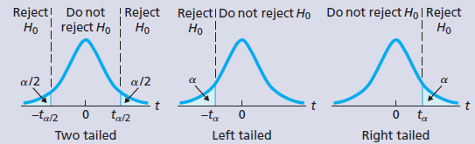
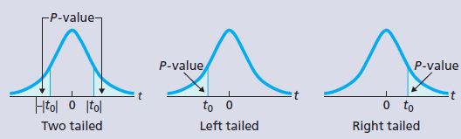
Procedure 7.2 (2 of 2)
Critical-value Approach
OR
P-value Approach
Step 4 The critical value(s) are
Step 4 The t-statistic has d f = n − 1. Use Table Ⅳ to estimate the P-value, or obtain it exactly by using technology.
with d f = n − 1. Use Table Ⅳ to find the critical value(s).
Step 5 If the value of the test statistic falls in the rejection region, reject
Step 5 If P ≤ α, reject
otherwise, do not reject
otherwise, do not reject
Step 6 Interpret the results of the hypothesis test.
Note: The hypothesis test is exact for normal populations and is approximately correct for large samples from nonnormal populations.

